Slide 1

Multivariate Data Analysis
MBS Defaulter Prediction Using Machine Learning Model
Vardhini Telu

Slide 2
Contents
Objective of study
Data description
Data Preprocessing
Exploratory data analysis
Feature extraction
Prediction Models
Conclusion
References

Slide 3

Objective of study
To predict Mortgage-Backed Securities (MBS) Defaulter using Machine Learning Model

Slide 4

Data Description
Data is obtained from Freddie Mac official portal for home loans:
(291452 x 28)
Some of the noteworthy features of the dataset are:
Credit score of the client
The maturity date of the mortgage
Percentage of insurance on the mortgage
Debt to income ratio of the borrower
Mortgage interest rate
Prepayment Penalty Mortgage- denotes if there is any penalty levied on prepayment of loan.
The number of borrowers issued the loan.

Slide 5
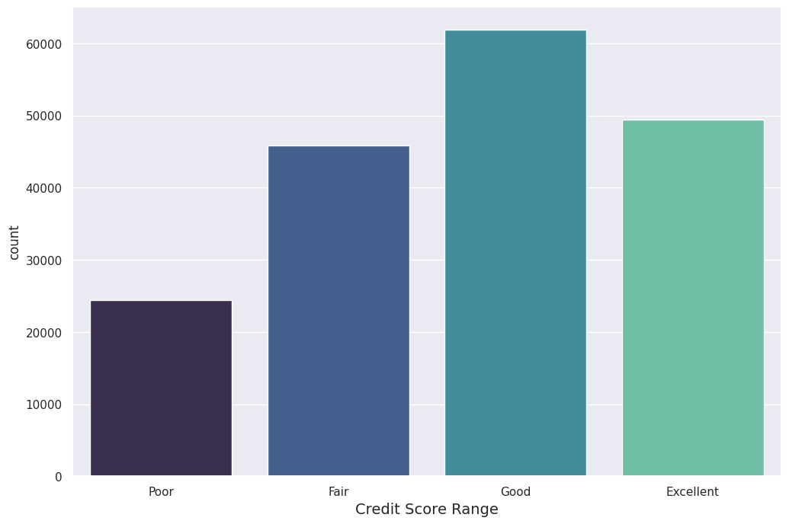
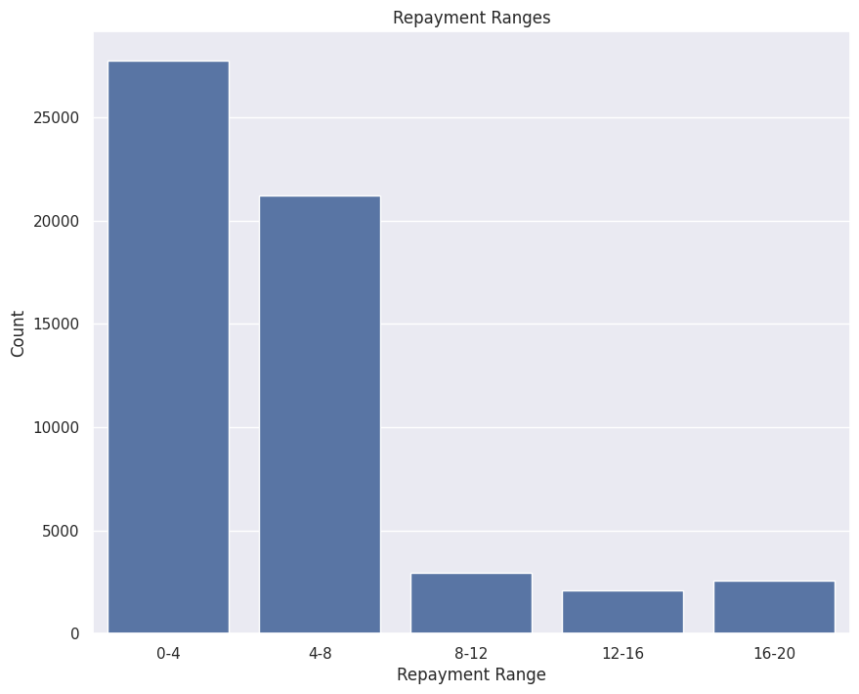
Data Preprocessing
Poor : < 650, Fair : 650 to 700,
Good : 700 to 750, Excellent : > 750
The people with the good credit score were given more loan than the excellent credit score.
Months in repayment column is transformed to Repayment Range
Most of the people have repaid the loan in the 0 to 4 year, and 4 to 8 years.

Slide 6
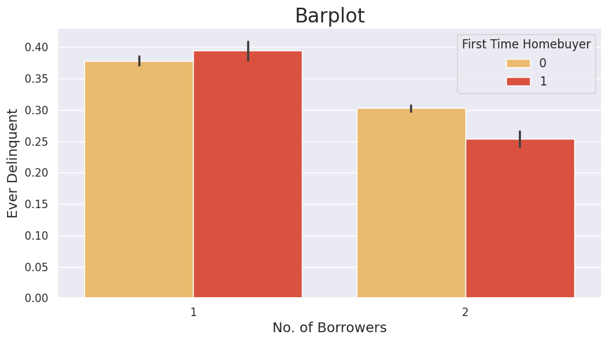
Exploratory Data Analysis
If the number of borrowers are 2 than the chance of being the defaulter is less.
2 borrowers First time Homebuyer have very less chances of defaulter

Slide 7
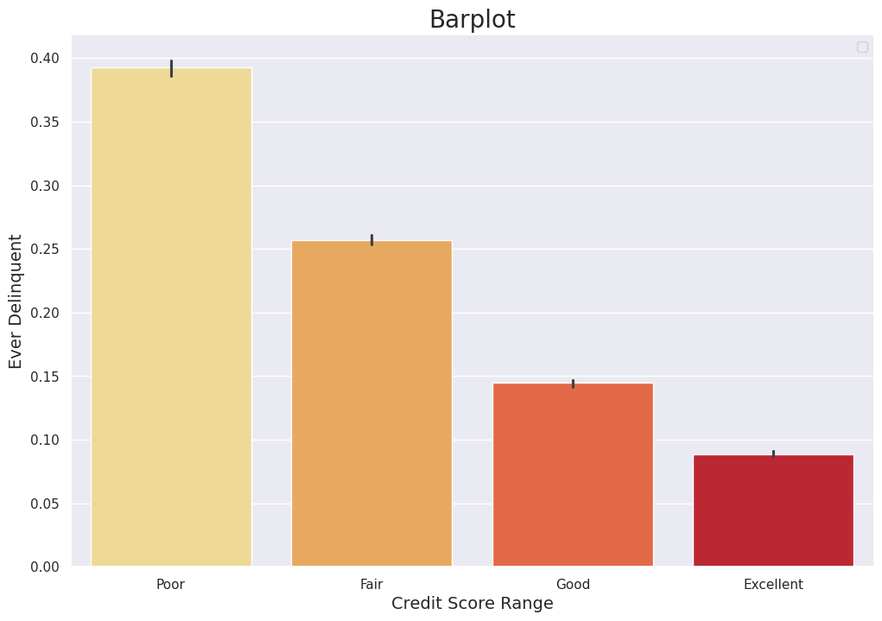
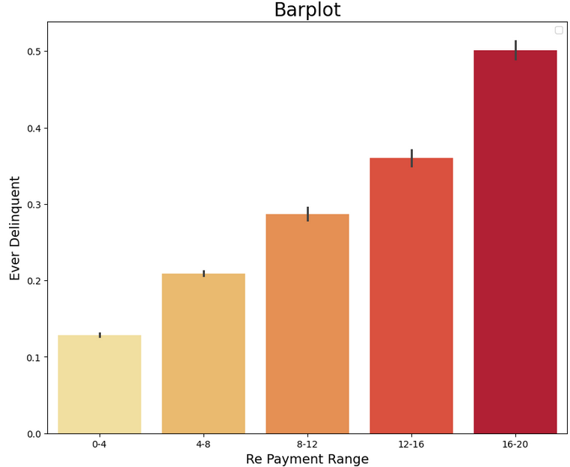
Exploratory Data Analysis…
There are high chances of being delinquent for loan repayment between 16 to 20 years
There is high chances of being delinquent for the poor credit score class.

Slide 8
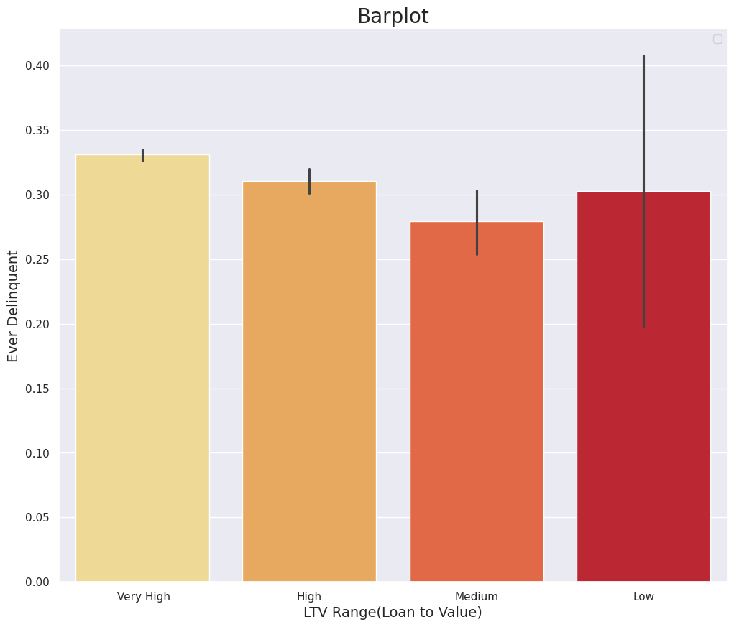
Exploratory Data Analysis…
There is no significant relation between the Loan to value (LTV) range of being delinquent.

Slide 9
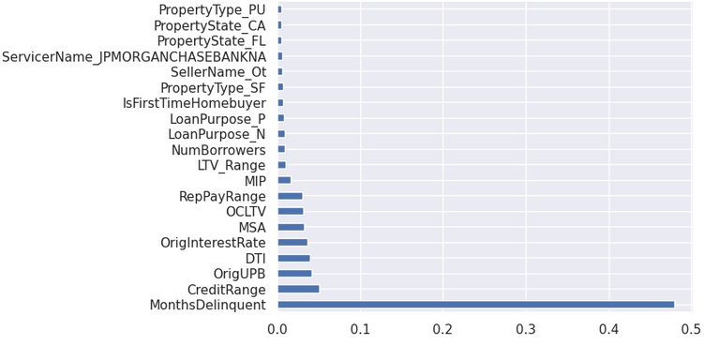
Feature extraction
Feature importance property of the model provides score for each feature .
Higher score indicates greater importance to output variable
Extra tree classifier, a tree based classifier is used to extract the 20 features.

Slide 10
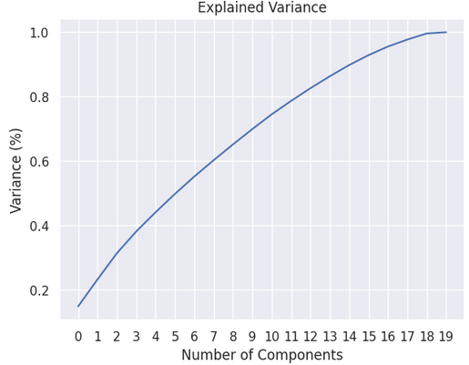
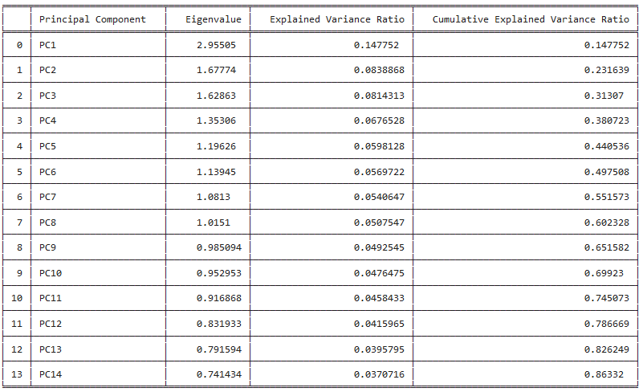
Principal component analysis
Curve of cumulative variance explained by the principal component.
86.33 % variance of the dataset is explained by top 14 principal components.

Slide 11
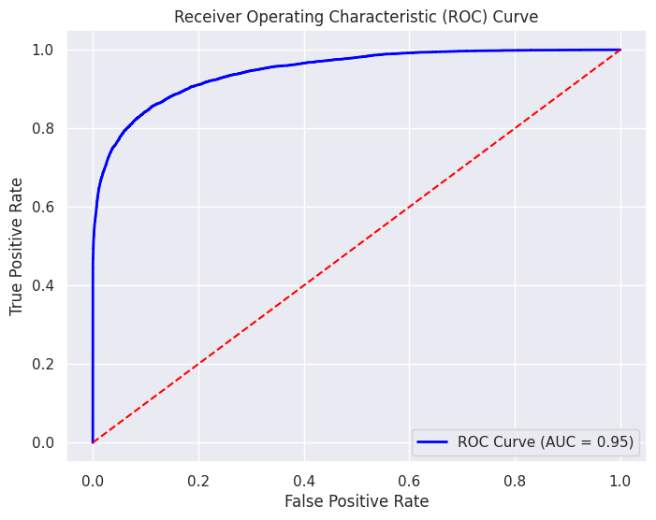
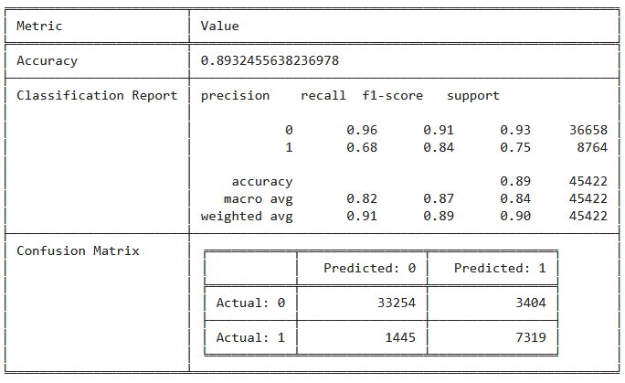
Logistics Regression Model for Predicting the defaulter
The accuracy of the logistic regression model is approximately 89.32%.

Slide 12
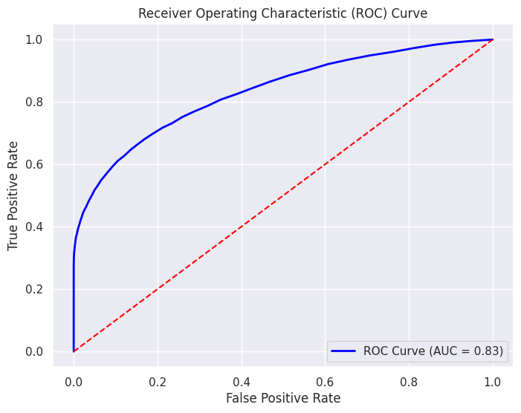
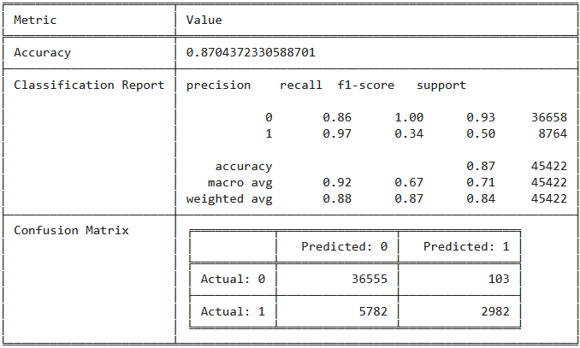
Random Forest Model for Predicting the defaulter
The accuracy of the logistic regression model is approximately 87.04%.

Slide 13
Conclusions
Single number borrowers, with poor credit score(0-650), and borrowers having 16-20 yrs of repayment are more delinquent.
Client with high Mortgage Insurance Premium and High Debt to Income ratio are more delinquent.
Accuracy of the Logistic Regression Model is 89.32% and that of Random Forest Model is 87.04%.
Those who are not subject to Prepayment penalty are more delinquent in PPM column.
Loan issued by the third party organisation in channel column having more delinquent.
Loan issued by seller Name "CR" is having more delinquent.

Slide 14
References:
Kanimozhi, P., Parkavi, S., & Kumar, T. A. (2023, April). Predicting Mortgage-Backed Securities Prepayment Risk Using Machine Learning Models. In 2023 2nd International Conference on Smart Technologies and Systems for Next Generation Computing (ICSTSN) (pp. 1-8). IEEE.
Link for the Dataset: Freddie Mac official portal
https://www.freddiemac.com/research/datasets/sf-loanlevel-dataset
Code link (Google collab):
https://colab.research.google.com/drive/1pESkpkvMUno3_Q9EA-GBiKtCrcOcET0y?usp=sharing

Slide 15

Thank you

